Slide 1


iCare
December 17th

Slide 2
Problem
You need help or you have someone who needs constant care:
You don’t have enough time to find him/her
You don’t know where you should find him/her
You have financial limitations.
You cannot find a trustable person.
You cannot find alternatives for your caregiver easily.

Slide 3
Solution
iCare offers a medium in which users can find caregivers.
Our team will ensure that our clients can take business trips or vacations or go to work knowing that their elderly relatives, kids are in good hands

Slide 4
Problem
Solution
Think about this that is the end of your semester You have exams, and your course project comes together. Besides all of them, you have someone in your house that needs constant care.
You need help or you have someone who needs constant care
iCare offers a medium in which users can find caregivers, nurses, or assistants.
Our team will ensure that our clients can take business trips or vacations or go to work knowing that their elderly relatives, kids are in good hands.

Slide 5
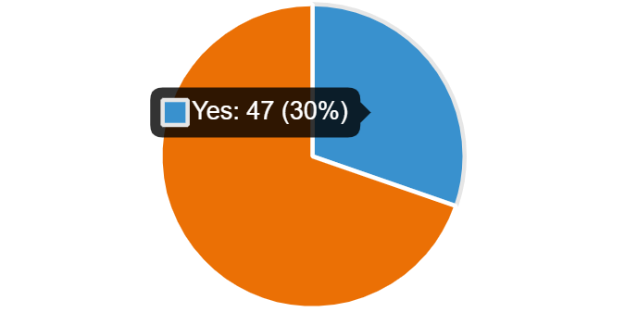
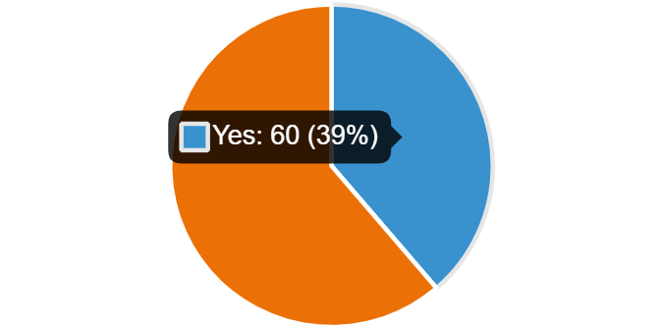
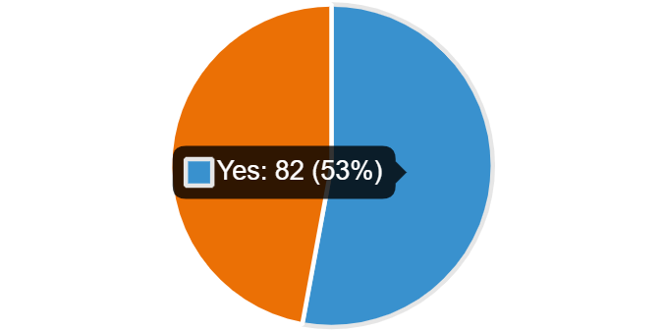
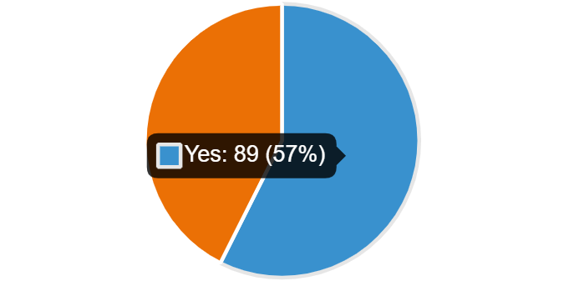
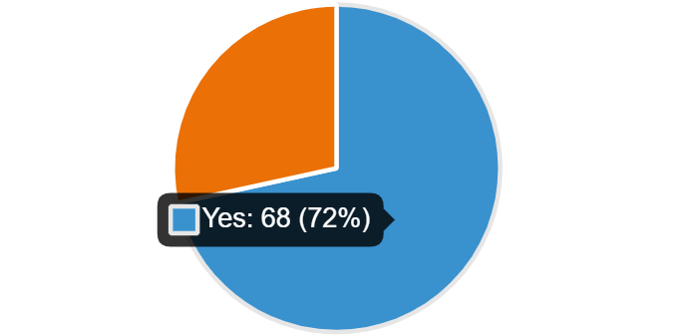
Target Market
Students’ Community:
Students who are getting help now
1.800.000
1.793.210
Students who cannot find suitable caregivers
1.500.000
1.200.000
900.000
Enrolled Students
Students who have someone that needs constant care
600.000
330.898
344.850
300.000
Registered Students
Graduate Students
Students who preferred searching online
Students who have a problem in communications

Slide 6








Competitors
Mobile app
Feedback and rating
Filtering through options
variety of services
Caregiver, Nurse, Assistant
iCare
Focus on Medical Care
Medwings
Sitly
Finding Babysitter
Caregiver, Nurse, Assistant
Solidali

Slide 7
Business model
We’ll take a 7% commission on each contract.
Yearly subscription from Service providers.
1.5 M
€ 75
€ 90M
Average Fee
Revenue
Share market
€ 10/hour @ 1month/part-time
2022-2024

Slide 8

Business model
iCare
Care-givers 7%
Consumers 2.5%

Slide 9
Milestone
Market entry
Public Lunch
Raise Money
Preparation
----
---
---
And the list goes on!
MVP
New Services
--
---

Slide 10

Monetization
iCare
Care-givers 7%
Consumers 2.5%
Net revenue
Year | Active Clients | Hours of service | Gross revenue | Net revenue
2022 | 10 | 2500 | €25,000 | €17,500
2023 | 20 | 6000 | €600,000 | €66,000
2024 | 100-120 | 1M | €10,000,000 | €700,000
2025 | 500 | 5M | €50,000,000 | €3,500,000
Key Metrics
Net revenue in thousand Euros

Slide 11


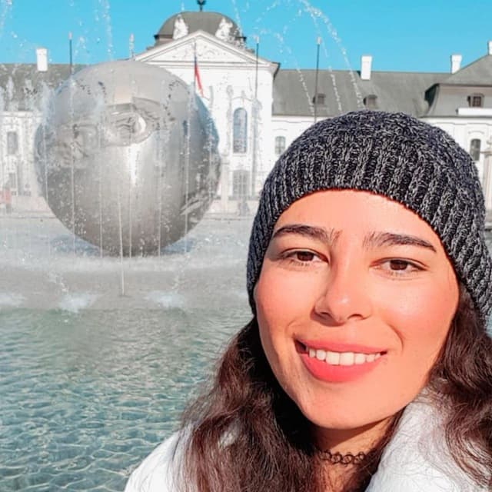
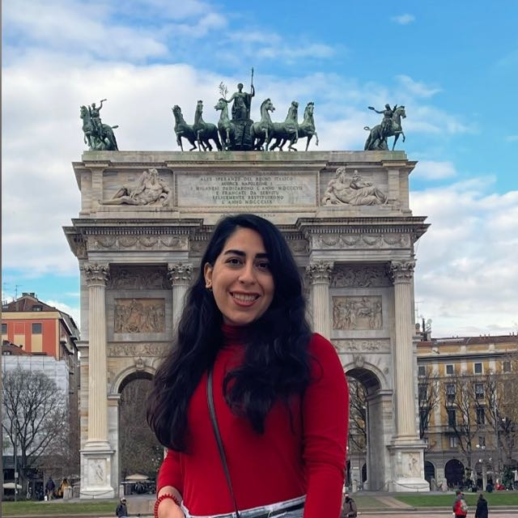

Our team
Razieh Ahmadi Design & Development
Farimah Anvari
CEO
Mansoure Ebrahimi
CMO
Sajedeh Firouzizadeh
CTO

Slide 12
Proof of Concept

Slide 13
Thank you!

Slide 14

Product demo
You can change the image on the screen with your own work. Just delete this one, add yours and center it

